Slide 1

Real-Time Mesh Utilities
Blerta Hamzallari Marco Klamke
Felix Griesau Simon Heinke
Julius Lerm Sugandha Sachdeva
Lars Debor Petros Simidyan
Notes:
1

Slide 2
Outline
Assignment / Task
Features
Status
Outlook
Software Demonstration
Slide 2
Notes:
2

Slide 3
Assignment/Task
Goal: Utilities for real-time capable interpolation and visualization of MEG/EEG sensor data
Slide 3
Notes:
3

Slide 4
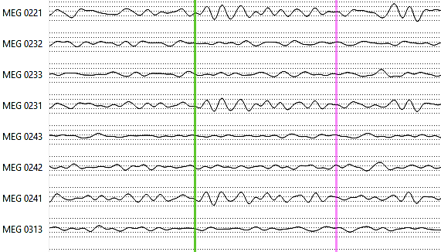
Standard Visualization
Slide 4

Slide 5
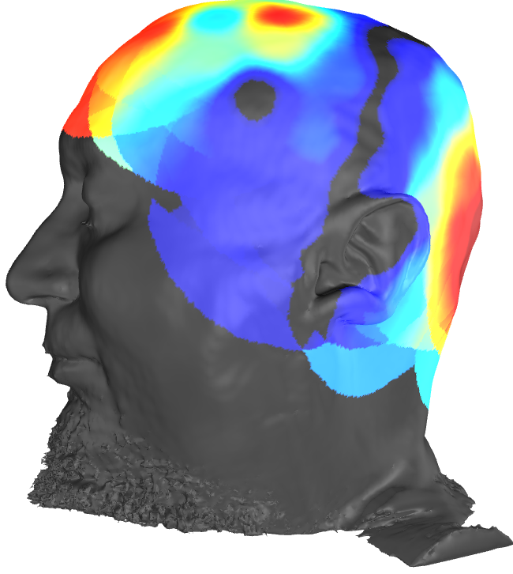
3D Realtime Visualization
Todo insert screenshot of disp3D
Slide 5

Slide 6

Input/Output
MNE-CPP
Input:
Vertices (x, y, z)
Neighbour-relationships
Sensor points (x, y, z)
Sensordata (1000hz)
Output:
Vector containing (interpolated) intensities for every vertex
Features
Slide 6

Slide 7
Features
Sensors
Mesh
Sensor Mapping
Slide 7
Notes:
7

Slide 8
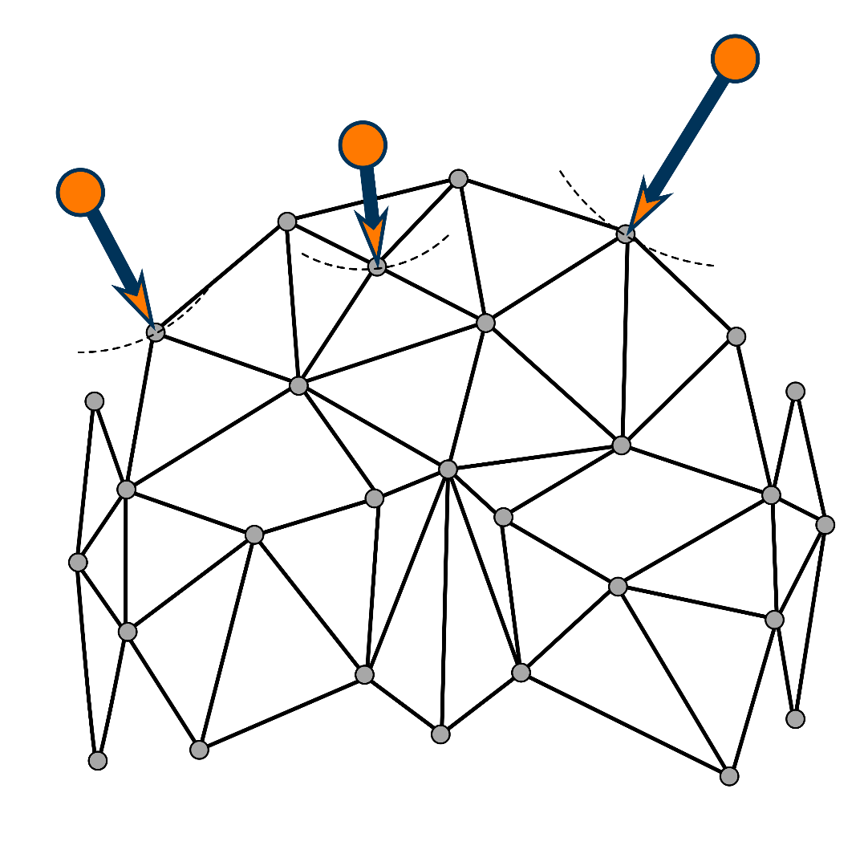
Sensor Mapping
Feature 1
Sensorpoints are not part of the mesh
Relative position on surface unknown
Multithreaded linear search
Slide 8
Notes:
8

Slide 9
Features
Sensors
Mesh
Sensor Mapping
Sensors on
Mesh
Mesh
SCDC
Slide 9
Notes:
9

Slide 10
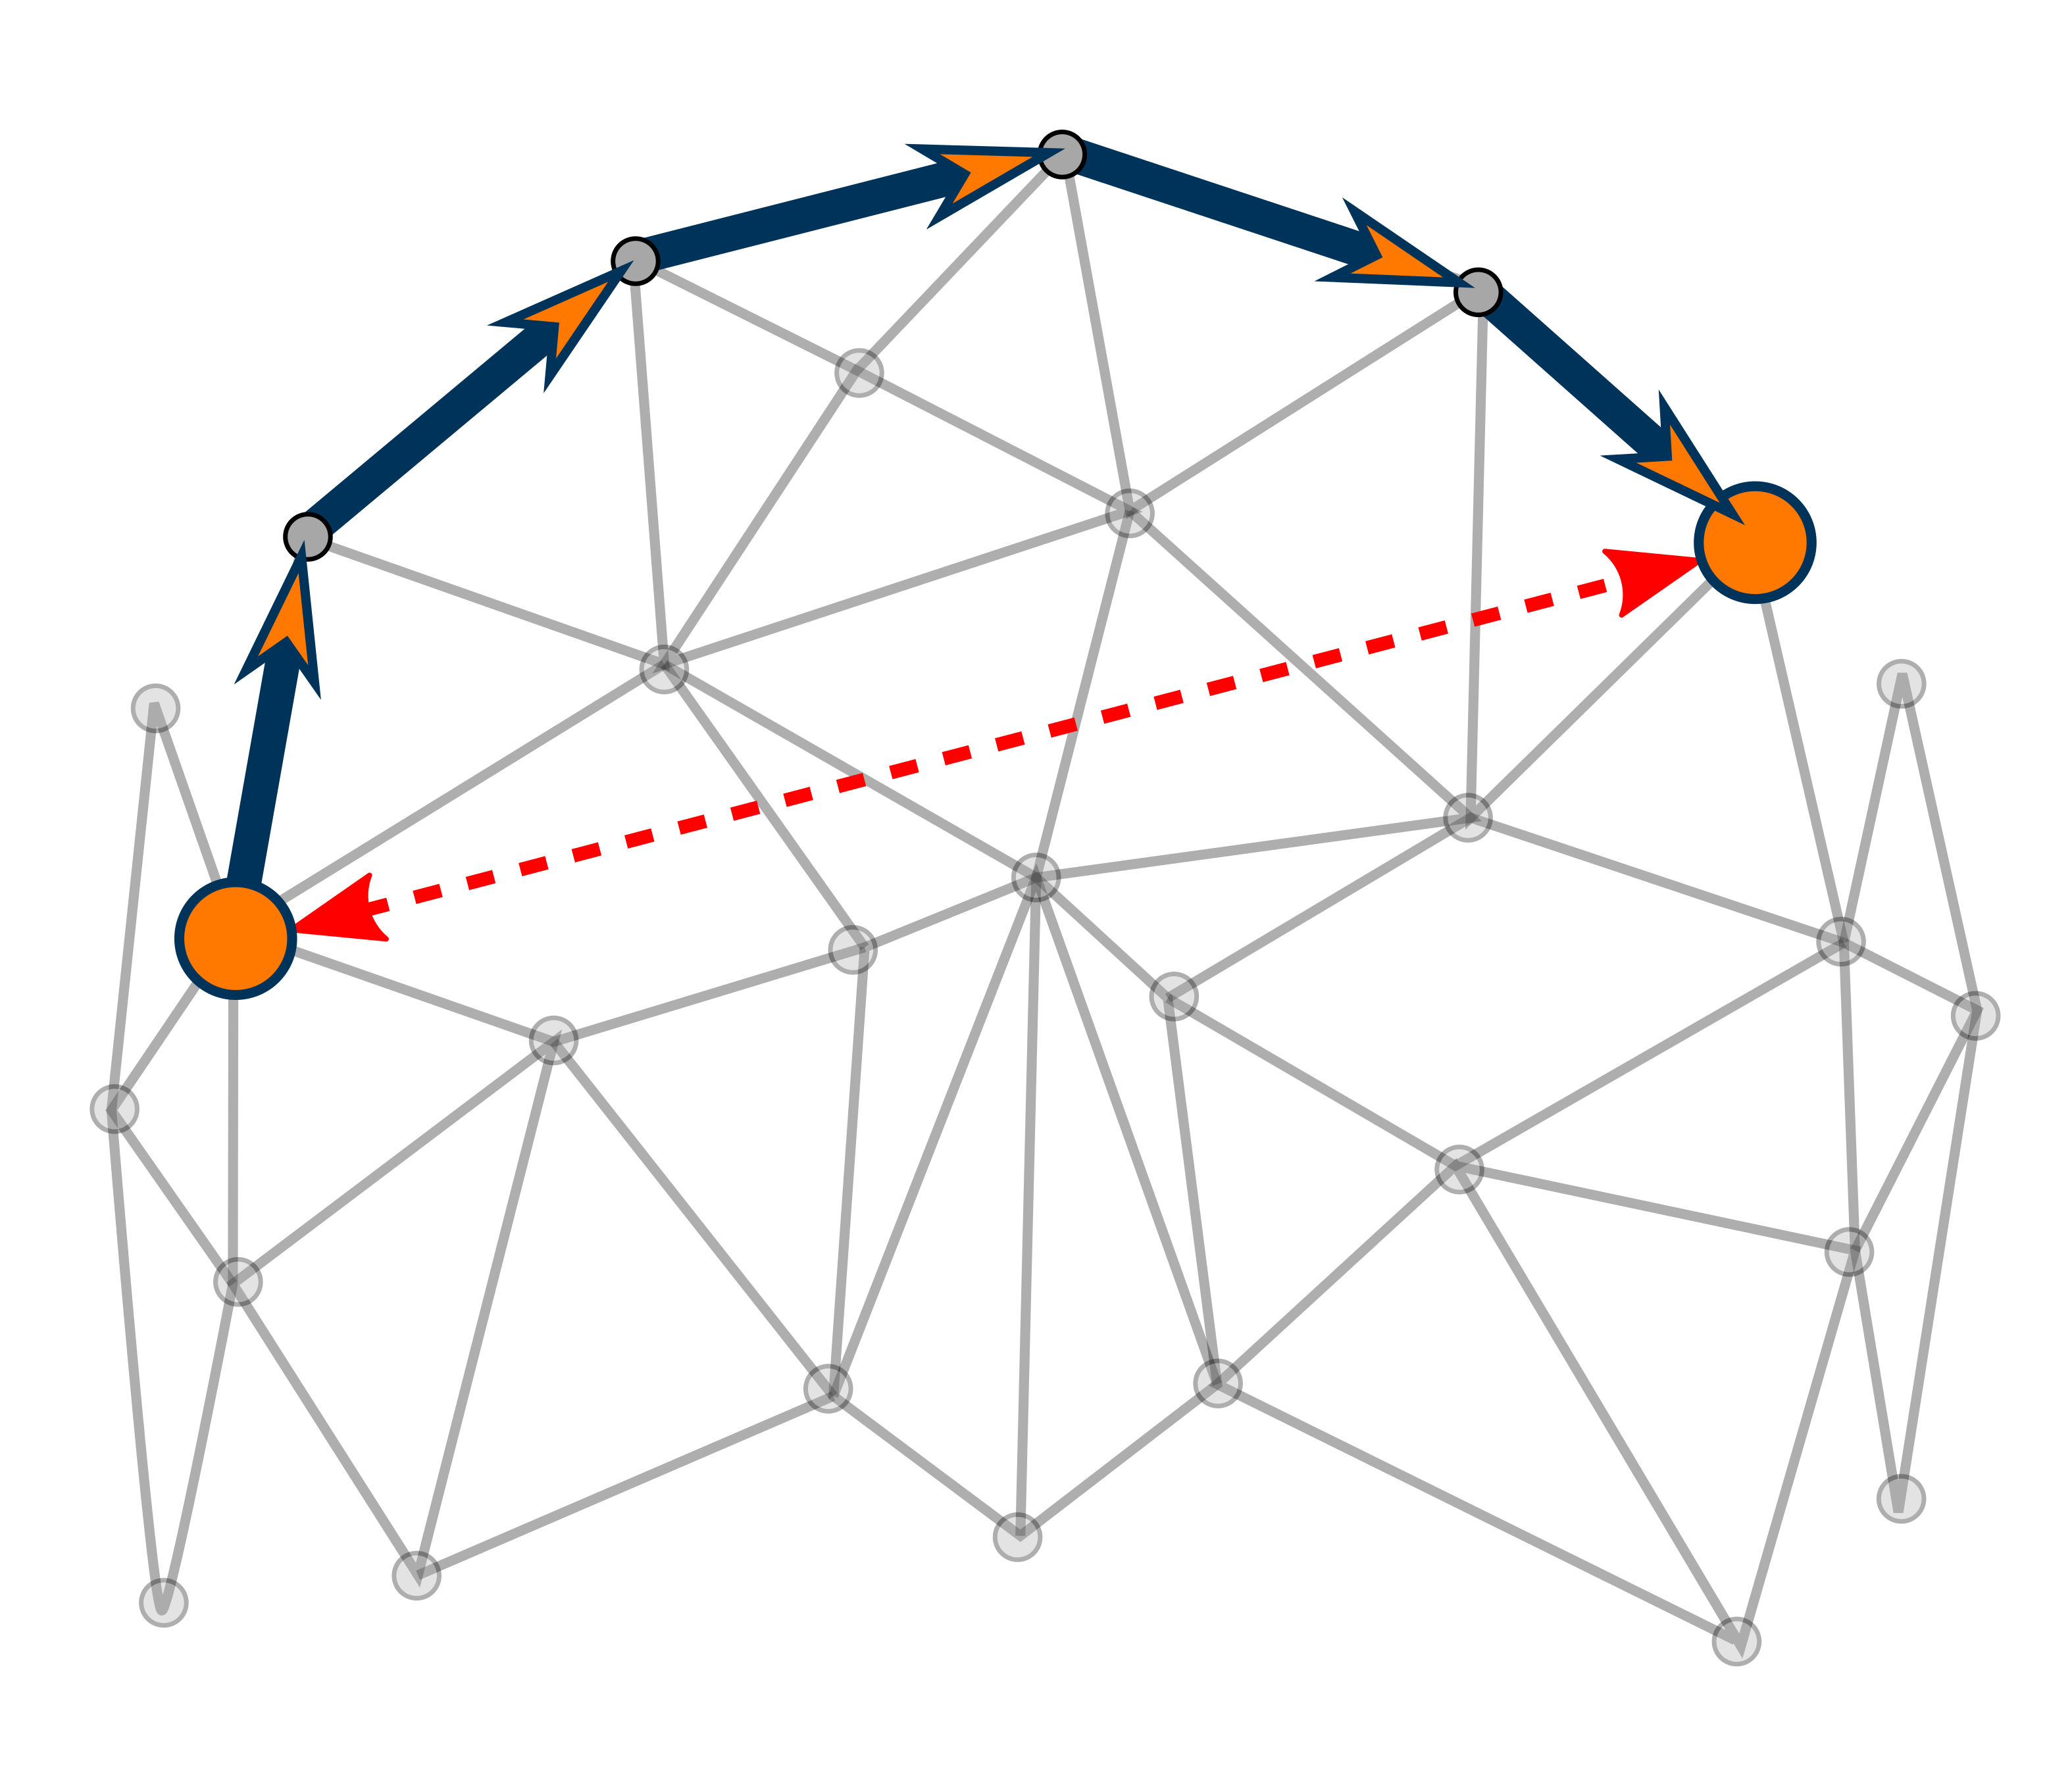
SCDC
Feature 2
(Surface-Constrained Distance Calculation)
Folded/Curved surface
Distance between 2 vertices?
Euclidian distance is inaccurate
Multithreaded iterative Dijkstra
Slide 10
Notes:
10

Slide 11
Features
Sensors
Mesh
Sensor Mapping
Sensors on
Mesh
Mesh
SCDC
Distance
Table
Function
Interpolation
Slide 11
Notes:
11

Slide 12
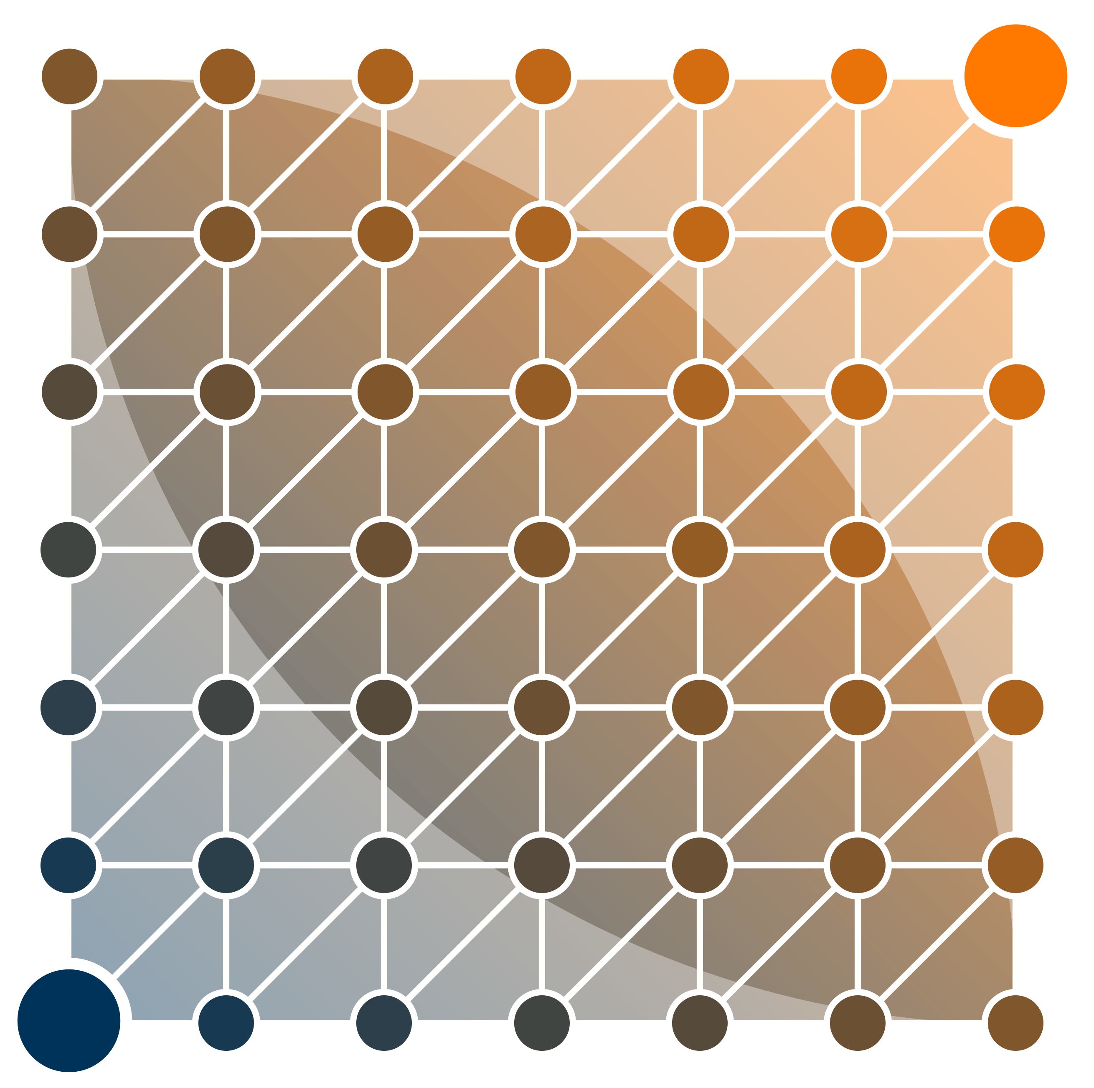
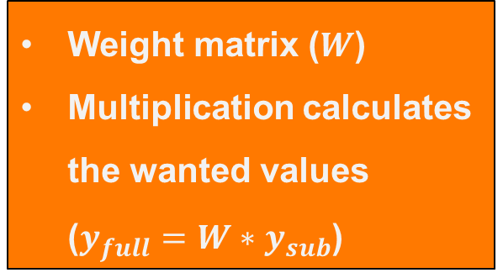
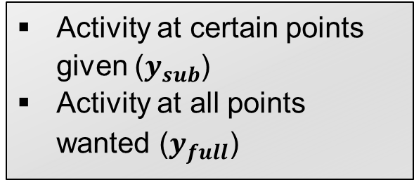
Interpolation
Feature 3
Activity at certain points given ($y_{sub}$)
Activity at all points wanted ($y_{full}$)
Weight matrix ($W$)
Multiplication calculates the wanted values ($y_{full}=W∗y_{sub}$)
Slide 12
Notes:
12

Slide 13
Features
Sensors
Mesh
Sensor Mapping
Sensors on
Mesh
Mesh
SCDC
Distance
Table
Function
Interpolation
Weight matrix
Signal Interpolation
Slide 13
Notes:
13

Slide 14
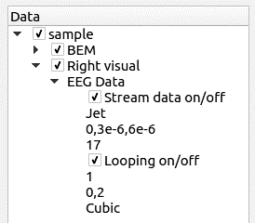
SensorDataTreeItem
Feature 4
The disp3D library has a tree structure
MetaTreeItems define the parameters of the algorithms
The SensorDataTreeItem manages the features
Sensor Mapping
Disp3D (Library)
SensorDataTreeItem
SCDC
Interpolation
Slide 14
Notes:
Der Baum ist noch nicht ganz so schoen :(

Slide 15
Features
Tree-Item
Sensors
Mesh
Sensor Mapping
Sensors on
Mesh
Mesh
SCDC
Distance
Table
Function
Interpolation
Weight matrix
Signal Interpolation
Slide 15
Notes:
15

Slide 16
Status
Features 1, 2, 3 and 4 implemented and operational
Computation highly performant
Integrated into existing project
Documented for further usage and development
Slide 16
Notes:
16

Slide 17
Review
All functional requirements fulfilled
Full SCDC needs more resources than estimated
Internal communication good
Detailed communication regarding the architecture with product owners sometimes complicated
Issue-tracking ineffective (not updated correctly, not logged correctly)
Feature 4 was far more complicated than estimated
Slide 17

Slide 18
Outlook
MNE-CPP is an Open-Source project
Therefore everyone can contribute
Further development ongoing
The generic features (SCDC, projecting, interpolation) will be used in other functionalities
The code is documented as required by the project, it fits in seamlessly
Slide 18
Notes:
18

